Slide 1
Thames Valley DeNDRoN: supporting Parkinson’s research <insert your name and contact details>
www.dendron.org.uk

Slide 2
What is DeNDRoN?
Dementias & Neurodegenerative Diseases Research Network (DeNDRoN)
Research arm of the NHS
National organisation
Parkinson’s, ataxia, dementias, Huntington's disease and motor neurone disease

Slide 3
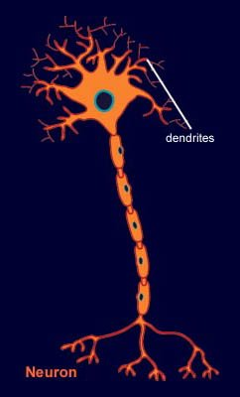
What is a dendron?

Slide 4
Thames Valley DeNDRoN
Team of nurses, doctors and research support workers
5 counties: Berkshire, Buckinghamshire, Leicestershire, Northamptonshire, Oxfordshire

Slide 5
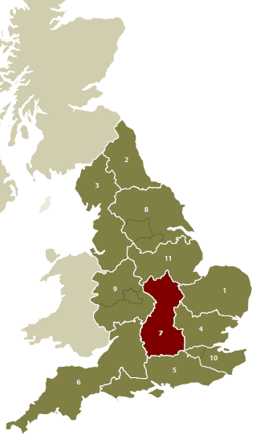
Thames Valley

Slide 6
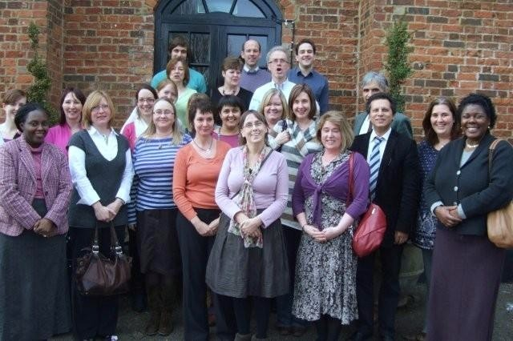
Thames Valley DeNDRoN Team

Slide 7
What do we do?
Help make more and better research happen in the NHS
Run research studies
Questionnaires
Biomarker studies
New or existing drug treatments
Studies of non-drug treatments
Tissue donation

Slide 8
Local Parkinson’s research
Monument Discovery Study
Eye tracking study
…
…

Slide 9
Monument Discovery Study
Aims to
Understand the very earliest changes in Parkinson’s
Develop knowledge about how to slow progression
The contribution of participants to this cutting edge research is highly valued

Slide 10
Monument Discovery Study
We are looking for over 1700 people with Parkinson’s, 300 controls and 300 family members
Running in six NHS trusts in Thames Valley
Parkinson’s diagnosis within last three years

Slide 11
Monument Discovery Study
Blood tests (genetic testing), cognitive and memory assessments, questionnaires, family history, mobility, smell tests, manual dexterity tests
Phase 2 (optional): skin biopsy, MRI scan, lumbar puncture

Slide 12
MONUMENT
DISCOVERY
PARKINSON’S
STUDY
HEATHERWOOD
& WEXHAM PARK
NEWBURY
ROYAL BERKSHIRE,
READING
MILTON KEYNES
GENERAL
HORTON,
BANBURY
AMERSHAM
HOSPITAL
STOKE MANDEVILLE
KETTERING
GENERAL
NORTHAMPTON
GENERAL
JOHN RADCLIFFE
OXFORD
MAIN SITE WITH CLINIC SATELLITE SITE FOR RECRUITMENT & REFERRAL

Slide 13
Discovery: the research clinic
Welcome, questions and consent
Clinical assessment with a neurologist
Blood test
Tea, coffee and biscuits

Slide 14
Discovery: the research clinic
Tests of memory and thinking
Blood Pressure/Pulse/Height/Weight
Smell tests
Mobility tests
Follow-up (every 18 months)

Slide 15
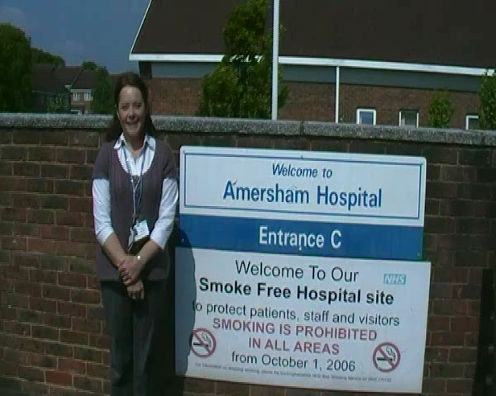

Slide 16
Tea & biscuits
NEED NICE PHOTO HERE ☺

Slide 17
Eye tracking study
Looking at changes in eye movements as an early indicator of Parkinson’s
Using a device that measures eye movements, we can record how your eyes respond to light
There seems to be a difference in eye movements between individuals who have Parkinson’s and those who do not

Slide 18
Eye tracking study
Takes approximately 30 minutes
You will be asked a few questions about your symptoms and to make some movements
Milton Keynes General and John Radcliffe, Oxford

Slide 19
Registering your interest
We would like to hear from you if you are interested in:
taking part in research
receiving updates about Parkinson’s research
offering your views and advice on how to make research more relevant to patients, carers and members of the public

Slide 20
Questions or ideas?
Get in touch!
< add your name, tel and email address >
You can make a difference!

